Slide 1



Group: 6
Submitted to: Lec. Nazneen Akhter, Lec. Rumana Yasmin
1

Slide 2




MEET OUR
TEAM MEMBERS
LATIFA NISHAT NISHI
ROLL NO. 2252421062
LAZMI CHOWDHURY
ROLL NO. 2252421108
TASNIMA TABASSUM BIPASHA
ROLL NO. 2252421110
2

Slide 3


Table of
Contents
01
Introduction
Comparision with other OS
06
02
Background
03
Features
07
Advantages
04
Applications
08
Limitations
09
Conclusion
Market Analysis
05
3

Slide 4

INTRODUCTION
Fedora Linux is a free and open-source operating system based on the Linux kernel, which is a set of programs that allows you to interact with your computer. It is always free to use, modify, and distribute. Fedora has a reputation for concentrating on invocation, developing new technologies, and closely working with upstream Linux communities.
4

Slide 5




OS FAMILY: UNIX LIKE
BACKGROUND
SOURCE MODEL: OPEN SOURCE
INITIAL INVENTOR: WARREN TOGAMI
SPONSORED BY: RED HAT LINUX
INITIAL RELEASE: 6 NOV, 2003
UPDATE METHOD: 0.5 YEARS PER RELEASE
NO QUESTIONS PLEASE WE ACCEPT CASH ONLY
5

Slide 6
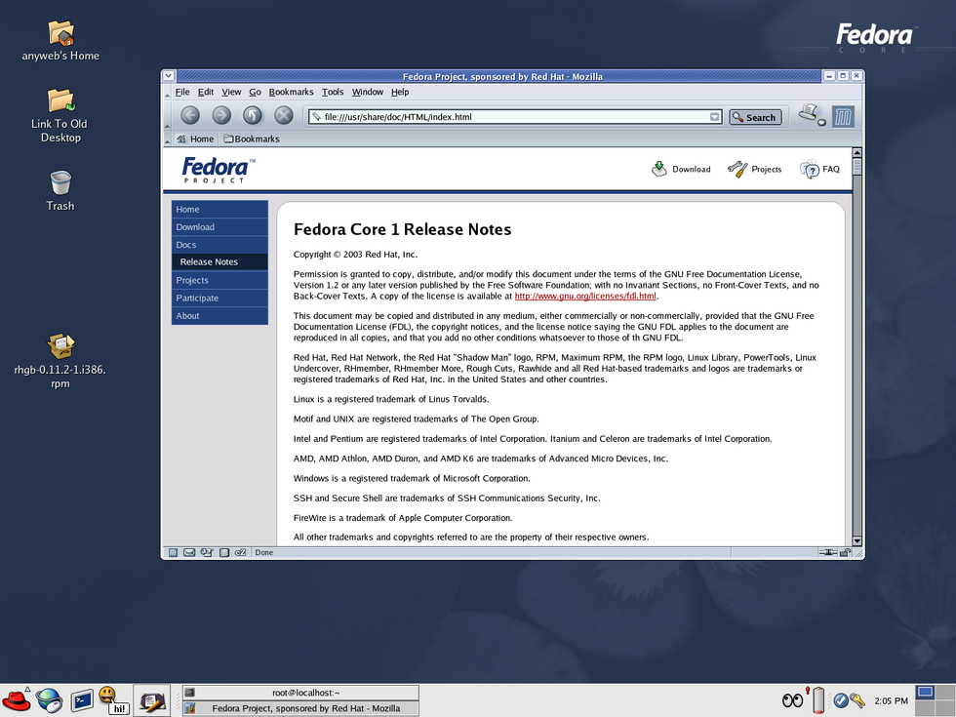
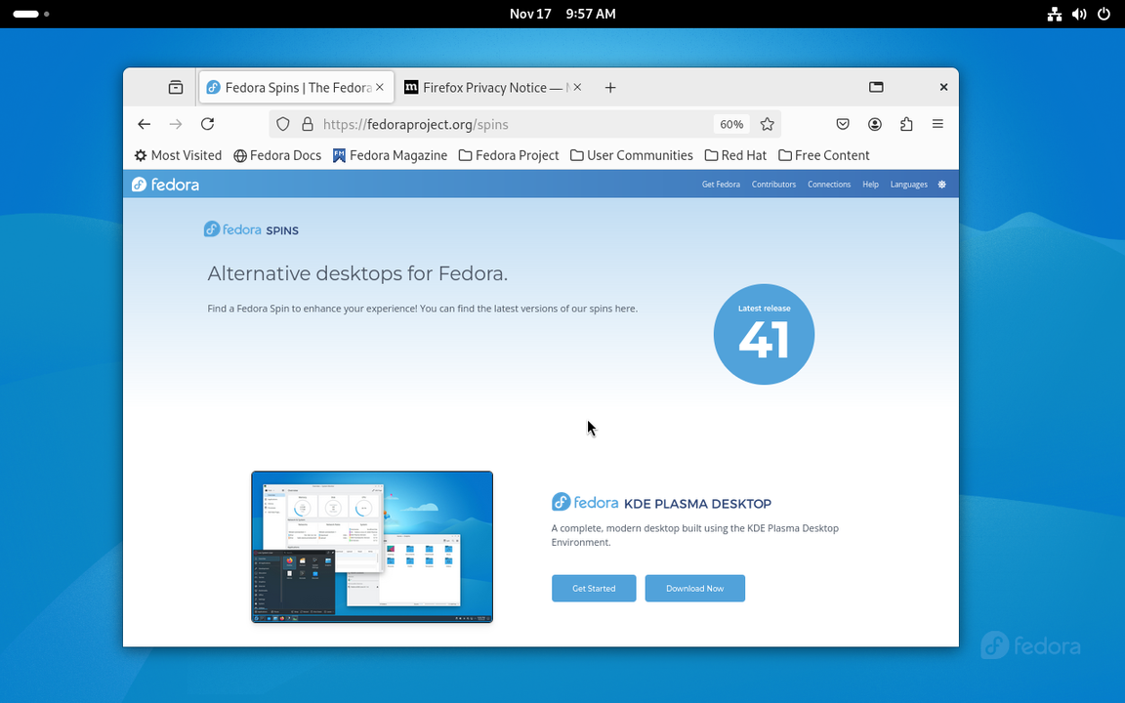

FEDORA CORE 1
FEDORA 41
6

Slide 7
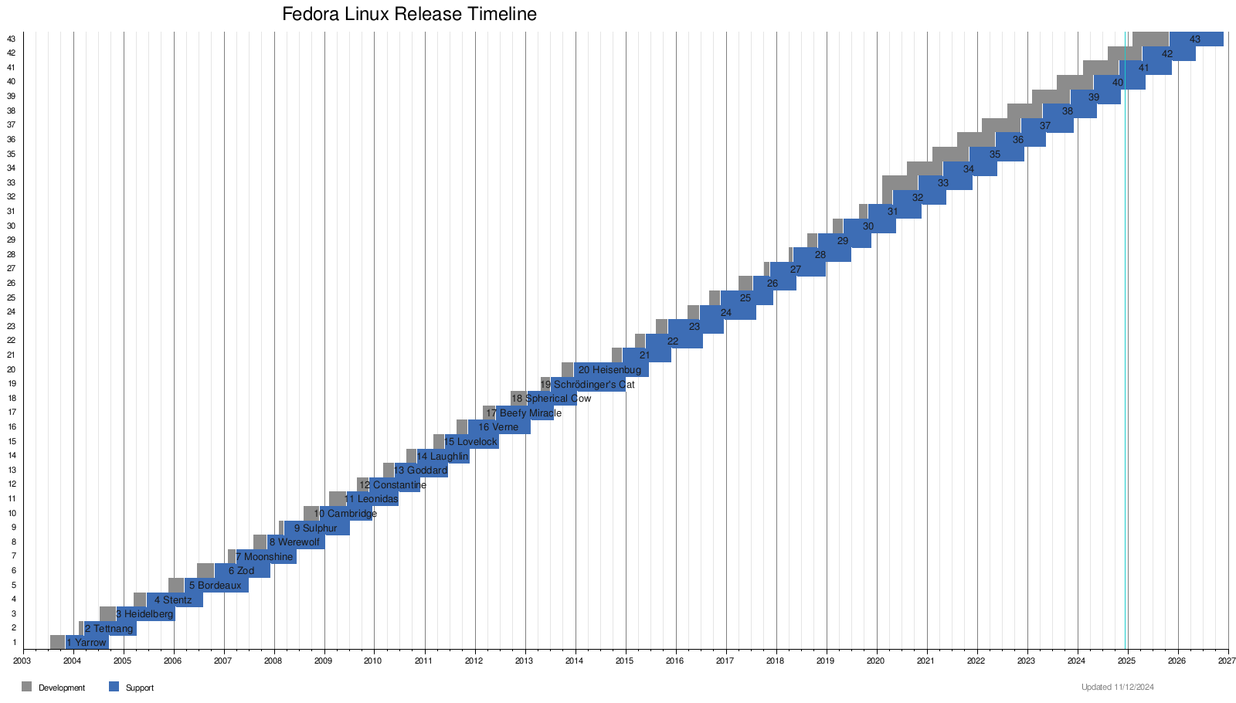
7
Source: Slideshare (May, 2024)

Slide 8
2003 Fedora Core 1, the first version of Fedora. | 2007 Before Fedora 7, Fedora was called Fedora Core after the name of two main repositories, Core and Extra. | 2010 Fedora 13, codenamed "Goddard",was released with automatic language packinstallation, control your colors for displays through the gnome-color-manager package. | 2013 Red Hat Enterprise Linux 7 and other derivatives are based on Fedora 19. MariaDB has replaced MySQL | 2014 Fedora 21, the first version without a codename, introduced three flavors providing preinstalled packages depending on use purpose: Workstation, Server, and Cloud. | PRESENT Fedora Linux 41 defaults to a new major release of the command-line package management tool DNF
POPULAR VERSIONS
41
21
19
13
7
1
8

Slide 9

MAIN EDITION
PRIMARY
SECONDARY
01
WORK STATION
06
02
SPIN AND REMIXES 6
SERVER
05
03
SILVER BLUE 5
INTERNET OF THINGS
04
CORE OS4
9

Slide 10

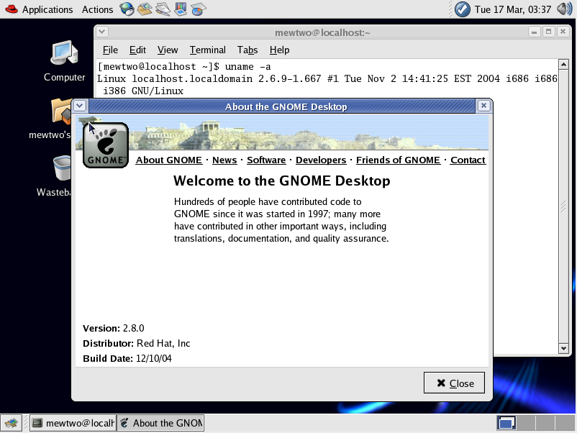
Ships With Stock GNOME:
Fedora appeals to users who prefer the familiarity of GNOME while still offering some extra features by keeping this mostly stock configuration
01
FEATURES
Providing Cutting-Edge Software:
updates every six months, and there is no LTS version, so you always get the most recent updates, and the most recent version is always the flagship edition.
02
Package Management:
uses the RPM( Red Hat Package Manager) Package Management System. It uses Delta RPM to install the packages.
03
Modularity in Software Stacks:
Implements modular repositories, allowing users to choose between different versions of software stacks like Node.js, Python, and Prent versions of the same software.
04
05
SELinux (Security-Enhanced Linux):
Security-Enhanced Linux) is enforced by default, providing mandatory access control (MAC)
10

Slide 11

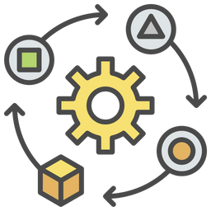

Unique Features of Fedora
Community-Led Development
Supported by Red Hat and the open-source community, Fedora focuses on collaborative innovation.
First to Adopt Technologies
Introduced Wayland and PipeWire, influencing many downstream distributions.
Btrfs File System
Fedora uses the Btrfs file system by default, which provides advanced features like snapshot capabilities, data compression, and self-healing for enhanced system stability and storage management.
11

Slide 12

APPLICATIONS
12

Slide 13


Software Development
A preferred platform for developers due to pre-installed tools like GCC, Make, Python, and Podman for containerized app development.
Fedora’s rolling-release model ensures access to the latest versions of libraries and programming tools.
Server Administration
Fedora Server Edition is used for web hosting, database management, and cloud-native applications.
Compatible with Kubernetes, Ansible, and virtualization tools like KVM for managing scalable infrastructures.
13

Slide 14


Containerization & DevOps
Podman and Buildah allow users to create and manage containers securely without requiring a daemon.
Used in CI/CD pipelines for software deployment and testing.
Cybersecurity & Network Management
Integrated tools like Wireshark, Nmap, and Fail2Ban for network monitoring and penetration testing.
Fedora’s SELinux ensures a secure environment for experimenting with cybersecurity frameworks.
14

Slide 15


AI and Machine Learning
Includes libraries and frameworks like TensorFlow, PyTorch, and Scikit-learn for advanced data analytics and AI development.
Supports CUDA for GPU-accelerated workloads.
IoT and Edge Computing
Fedora IoT Edition is optimized for edge devices with features like OSTree for atomic updates and Greenboot for system health checks.
15

Slide 16


Multimedia Production
PipeWire, combined with tools like Blender and Audacity, makes Fedora ideal for professional-grade audio, video editing, and 3D modeling.
Educational and Academic Research
Widely adopted in universities for teaching Linux system administration, programming, and OS design.
Used for simulations and HPC with support for OpenMPI and SLURM.
16

Slide 17



MARKET
ANALYSIS
17

Slide 18
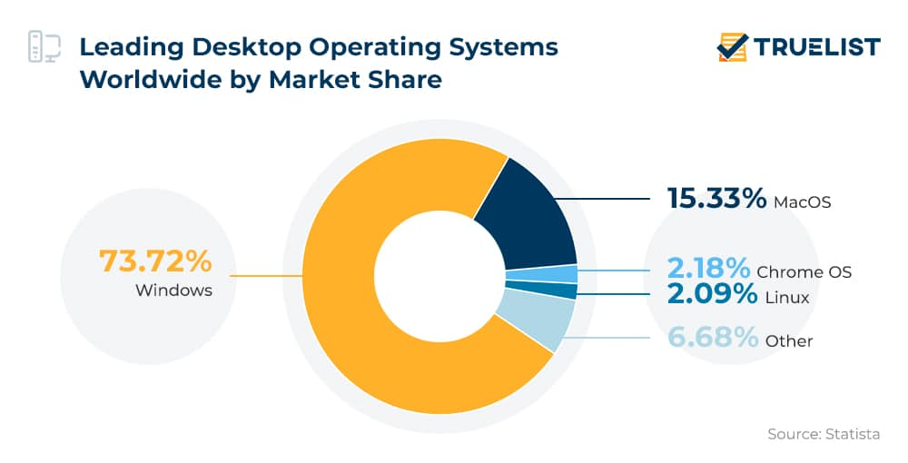
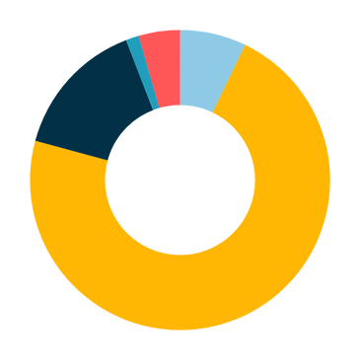

Linux Market Share on Desktops
As of 2024, Linux accounts for approximately 4.45% of the desktop operating system market. This is a significant growth, but it still places Linux behind Windows (72.08%) and MacOS (14.92%). Chrome OS accounts for 1.41%​
14.92%
MacOS
72.08%
Windows
1.41%
Chrome OS
4.45%
Linux
7.14%
Others
Source: Statista (July, 2024)
18
Notes:
B. Elad, “Linux Statistics 2022 - Market Share, Usage Data and Facts,” Enterprise Apps Today, Jul. 12, 2022. https://www.enterpriseappstoday.com/stats/linux-statistics.html
‌

Slide 19
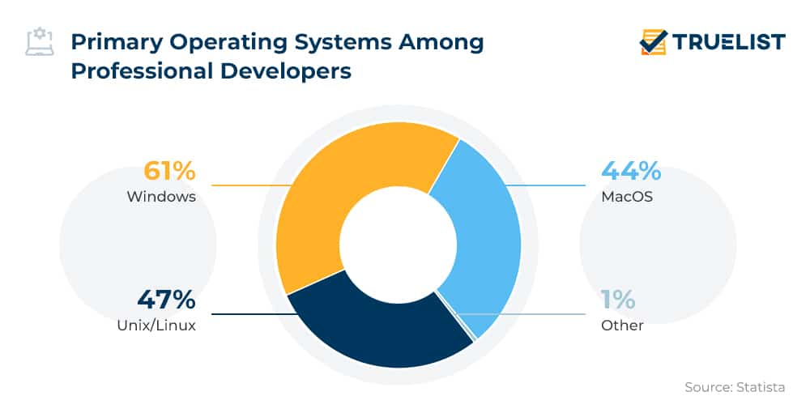

Fedora's Niche
Fedora appeals primarily to developers and tech enthusiasts due to its bleeding-edge features and close ties with Red Hat Enterprise Linux (RHEL). It's widely used in professional environments for cloud-native applications and container orchestration.
Source: Statista (July, 2024)
19
Notes:
B. Elad, “Linux Statistics 2022 - Market Share, Usage Data and Facts,” Enterprise Apps Today, Jul. 12, 2022. https://www.enterpriseappstoday.com/stats/linux-statistics.html
‌

Slide 20
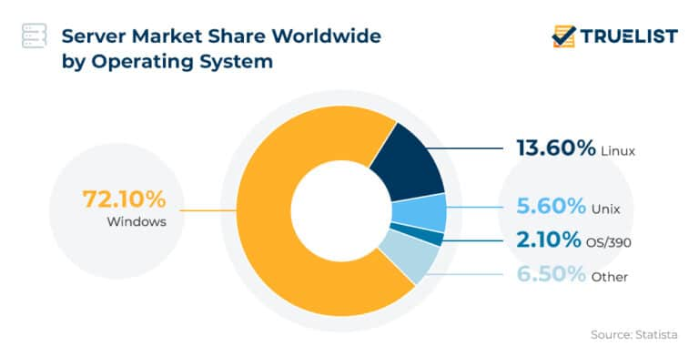

Linux Market Share on Supercomputers and Servers
In the server domain, Linux accounted for 13.6% globally in 2019, showcasing significant usage in infrastructure.
Also, Linux dominates in the supercomputing world, powering almost 50% of the top 500 supercomputers​. Fedora, while not as common in these systems, contributes to innovations that benefit the Linux ecosystem.
Source: Statista (July, 2024)
20
Notes:
B. Elad, “Linux Statistics 2022 - Market Share, Usage Data and Facts,” Enterprise Apps Today, Jul. 12, 2022. https://www.enterpriseappstoday.com/stats/linux-statistics.html
‌

Slide 21
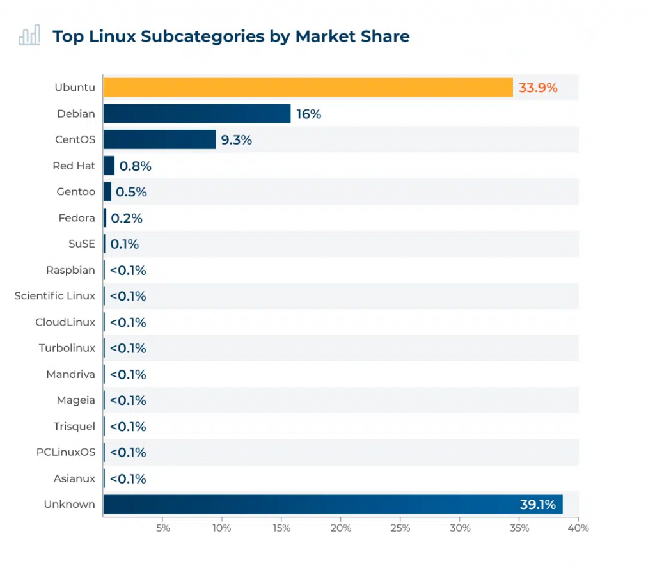
Comparison with Other
Linux Distributions
Ubuntu leads Linux desktop adoption at nearly 34% among Linux users globally, while Fedora holds a smaller share. However, Fedora's rapid updates and innovation make it a leader in cutting-edge feature
21
Source: W3Techs (July, 2024)
Notes:
B. Elad, “Linux Statistics 2022 - Market Share, Usage Data and Facts,” Enterprise Apps Today, Jul. 12, 2022. https://www.enterpriseappstoday.com/stats/linux-statistics.html
‌

Slide 22
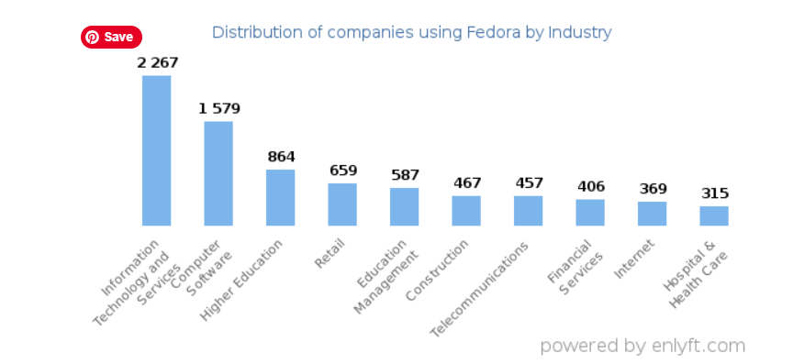
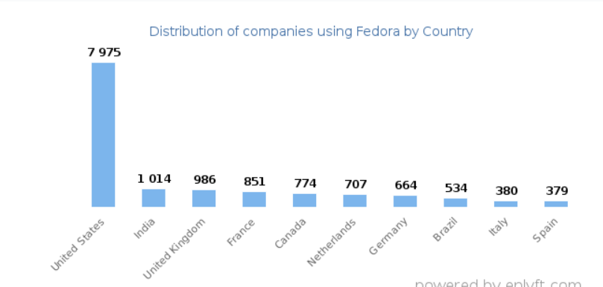
Top Industries that use Fedora
Top Countries that use Fedora
Source: Enlyft (December, 2024)
Looking at Fedora customers by industry, we find that Information Technology and Services (10%) and Computer Software (7%) are the largest segments.
Source: Enlyft (December, 2024)
34% of Fedora customers are in United States.
22
Notes:
B. Elad, “Linux Statistics 2022 - Market Share, Usage Data and Facts,” Enterprise Apps Today, Jul. 12, 2022. https://www.enterpriseappstoday.com/stats/linux-statistics.html
‌

Slide 23


Market Size
The global Linux market is expected to reach $15.64 billion by 2027, with a compound annual growth rate (CAGR) of 19.2%. This growth is driven by the increasing number of servers, rising internet penetration rates, and the expansion of data centers.
15.64 billion
23
Notes:
B. Elad, “Linux Statistics 2022 - Market Share, Usage Data and Facts,” Enterprise Apps Today, Jul. 12, 2022. https://www.enterpriseappstoday.com/stats/linux-statistics.html
‌

Slide 24

COMPARISION
WITH OTHER
OS
24

Slide 25
Comparision with various operating systems
Feature | Fedora | Android OS | macOS | Windows
Source Model | Open-source, community-driven, leading-edge | Open-source core with proprietary services | Proprietary (Unix-based) | Proprietary
Customization | Highly customizable (GNOME by default, KDE, Xfce available) | Limited (requires rooting for full control) | Moderate (UI customization only) | Limited (GUI and settings only)
Security | High security with SELinux enabled by default | Strong (sandboxed apps, Google Play Protect) | Strong (sandboxing, Gatekeeper) | Moderate (frequent malware target)
Application Management | DNF package manager with Flatpak and RPM support | Google Play Store and APK files | macOS App Store | Microsoft Store + EXE/MSI files
Primary Use | Development, servers, containers, workstations | Mobile devices, IoT | Apple-exclusive devices | Personal, professional, gaming
Performance | Optimized for modern hardware; lightweight Workstation Edition | Optimized for mobile devices | Optimized for Apple hardware | Varies based on hardware
Hardware Compatibility | Wide compatibility (supports x86_64, ARM, and cloud setups) | Limited to Android-compatible devices | Exclusive to Apple hardware | Wide range (supports most OEMs)
User-Friendliness | Beginner-friendly (Fedora Workstation) with robust developer tools | Very user-friendly | User-friendly (intuitive UI) | Very user-friendly
25

Slide 26




Popular linux distributions
UBUNTU
LINUX MINT
one of the most popular linux distribution.
A popular desktop linux
KALI LINUX
DEBIAN LINUX
widely used for penetration.
One of the first linux distributions,publish in 1993.
26

Slide 27
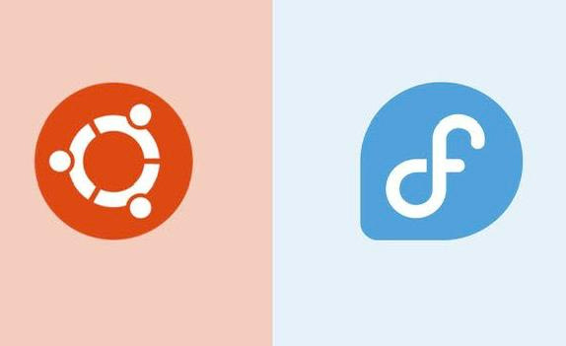
FEDORA VS UBUNTU
Fedora’s desktop edition uses Grome 3 with Grome shell. | Ubuntu default desktop edition is unity
 | Ubuntu uses DPKG and .deb packages.
Fedora’s bleeding-edge software and developer-friendly environment. | Ubuntu user-friendly interface and LTS version make it excellent choice for beginners.
Fedora is not typically considered a primary choice for gaming. | Ubuntu has gained popularity among gamers.
Fedora uses RPM with .rpm packages.
27

Slide 28

FEDORA VS KALI LINUX
Fedora target builders,open-source fans and versatile platform for software development. | kali linux caters to cybersecurity experts and fans who require roburst toolkit for penetration,network evaluation.
Fedora employs the Dandified YUM (DNF) package manager,controls machine clean setup,updates. | Kali linux utilizes Advanced Package Tool (APT) as its package deal control gadget.
It adopts the Security-Enhanced Linux framework. | It comes with various pre-mounted security equipment,such as scanner,password-cracking.
Fedora benefits from a massive and energetic open-source community. | Kali linux has a colourful community of safety experts and moral hackers.
28

Slide 29
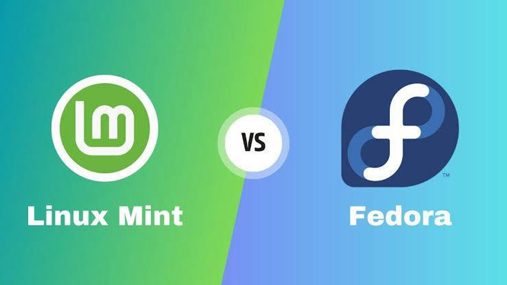
FEDORA VS LINUX MINT
Based on Red Hat,uses the RPM package manager and DNF. | Based on Ubuntu ,uses the APT package manager with DEB packages.
Follows a fast -placed releases cycle,with new versions. | It ensures longer support periods and stability.
Excellent hardware support for the latest devices and technologies. | Lighter on resources and performs well on older hardware.
Focuses on free and open-source software. | More beginner friendly with pre-installed software like office tools.
29

Slide 30
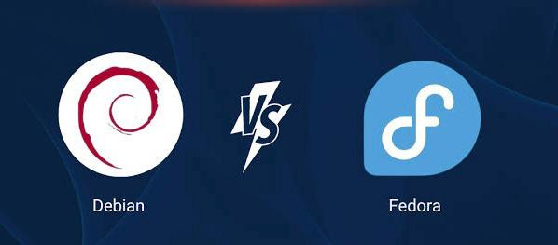
FEDORA VS DEBIAN LINUX
Fedora’s cutting-edge nature may not be as stable as Debian’s. | Debian is very stable.
Fedora is ideal for users who want to stay on the leading edge of open-source technology | Debian is ideal for user seeking a highly stable and secure system ,making it suitable for production.
Fedora takes a more progressive release model,prioritizing the inclusion of eading-edge software and features. | Debian follows a conservtive release model, prioritizing stability and reliability.
Fedora uses the DNF package managemnt system. | Debian uses the APT package management system.
30

Slide 31

“Great Minds Think Alike”
Linus Torvalds,
the creator of Linux, uses the
Fedora Linux distribution.
31
Notes:
B. Elad, “Linux Statistics 2022 - Market Share, Usage Data and Facts,” Enterprise Apps Today, Jul. 12, 2022. https://www.enterpriseappstoday.com/stats/linux-statistics.html
‌

Slide 32

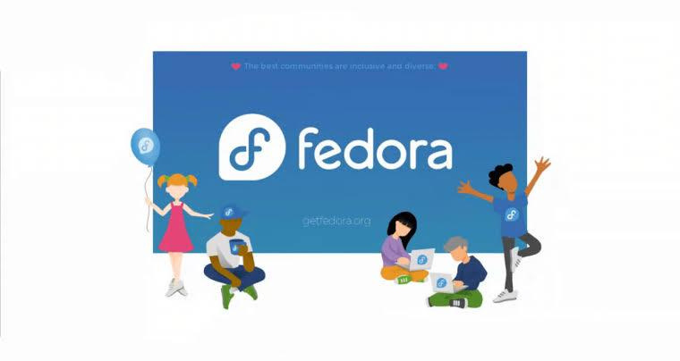
ADVANTAGES
Freedom:
Most linux distros are free,user do not need to pay for a copy.
latest linux kernel:
supports latest version of kernel.
Stable:
linux system rarely crash.
Time:
Linux not easily become bogged down with spyware,viruses etc.
Performance:
provides high performance on workstations and outerworks.
Network freindliness:
Strong support for network functionality,network backup faster.
32

Slide 33

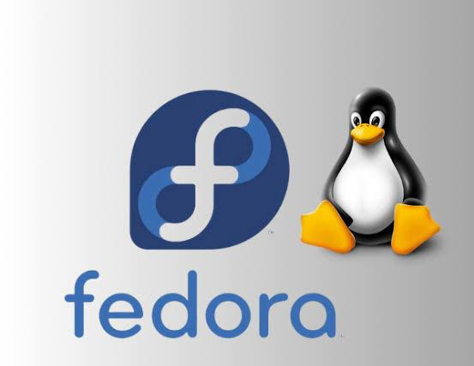
LIMITATIONS
Many windows programs will not run .
Project 1
It requires long time to set up
It does not have any standard model for multi file objects.
It requires additional software tools for the server.
Stability concern.
33

Slide 34

CONCLUSION
Fedora, with its advanced features, delivers exceptional performance and capabilities, making it one of the most prominent Linux distributions. Its short-term and regular updates ensure that users have access to the latest software versions and cutting-edge functionalities. Designed with innovation and flexibility in mind, Fedora is an excellent choice for development environments, offering a seamless blend of modern technology and a polished user experience.
34

Slide 35
THANK YOU
QUERY PLEASE !
35

Slide 36
Reference
[1] Elad, B., “Linux statistics 2024 by market share, usage data, number of users and facts, Enterprise Apps Today.” Available at: https://www.enterpriseappstoday.com/stats/linux-statistics.html (Accessed: 12 December 2024).
[2] Branka, “Linux Statistics 2024 (2024) TrueList.” Available at: https://truelist.co/blog/linux-statistics/ (Accessed: 15 December 2024).
[3] “Fedora commands 0.56% market share in Operating Systems,” enlyft.com, Available at: https://enlyft.com/tech/products/fedora (Accessed: 16 December 2024).
[4] Awati, R. (2023), “What is Fedora Linux? – TechTarget Definition, Search Data Center. TechTarget.” Available at: https://www.techtarget.com/searchdatacenter/definition/Fedora (Accessed: 18 December 2024).
[5] “GeeksforGeeks (2024) Fedora Linux Operating System, GeeksforGeeks. GeeksforGeeks.” Available at: https://www.geeksforgeeks.org/fedora-operating-system/ (Accessed: 18 December 2024).
[6] “9 Best Linux Distros in 2024 (2024) RunCloud Blog.” Available at: https://runcloud.io/blog/best-linux-distros#2--fedora (Accessed: 18 December 2024).
‌
‌
‌
36

